Slide 1
The role of Bacteria and fungi in the food industry
By devansh sharma

Slide 2
What is the role?
You may think that bacteria and fungi are very dangerous and harmful. Well that is true but did you know that it is still used in food industry. So we people are eating poison? NO!!!!!! Well it does not kill us but still it has some good effects on our body.
We can take food which uses bacteria and fungi such as: Bread, Cheese, Milk, Wine, Beer, Meat(Some How), Vinegar, Fermented Fish, and Vegetables.
Microorganisms are essential for the production of foods such as cheese, yogurt, bread, beer, wine and other fermented foods. ... Certain bacteria, including lactic acid bacteria, are used to make yogurt, cheese, hot sauce, pickles, fermented sausages and dishes.
Bacteria, molds and yeast are the most important microorganisms that cause food spoilage and also find the maximum exploitation in production of food and food products. Different strains of bacteria and fungus are used for fermentation of dairy products for production of a wide variety of cultured milk products.
A main example of Fungi in the food industry can be the Mushroom.

Slide 3
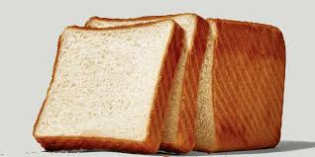

Slide 4
Fact
Did you know that bacteria and fungi is sometimes in medicine.

